Slide 1
Truth Maintenance System
Prof. Dr. A K M Akhtar Hossain
Dept. of CSE, RU

Slide 2
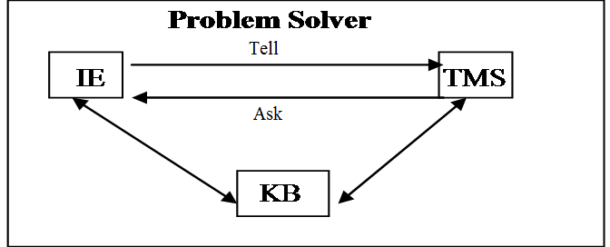
*****Truth Maintenance System (TMS)
Definition of TMS:
Truth maintenance system (TMS) works with inference engines for solving problems within large search spaces.
The TMS and inference engine both put together can solve problems where algorithmic solutions do not exist.
TMS maintains the beliefs for general problem solving systems.
IE – Inference Engine
KB – Knowledge Base

Slide 3
TMS – Cont …
TMS can be used to implement monotonic or non-monotonic systems.
In monotonic system, once a fact or piece of knowledge is stored in KB, it can not change.
  In monotonic reasoning, the world of axioms continually increases in size and keeps on expending.
  Predicate logic is an example of monotonic form of reasoning. It is a deductive reasoning system where new facts are derived from the known facts.
Non-monotonic system allows retraction of truths that are present in the system whenever contradictions arise.
  So number of axioms can both increase and decrease and depending upon the changes in KB, it can be updated.

Slide 4
Example – Monotonic TMS
Suppose we are given the premise set ∑ = {P, W} and the internal constraint set
{P → Q, (P Λ W) → R, (Q Λ R) → S}.
TMS are able to derive S from these constraints and the premise set ∑.
TMS should provide the justifications of deriving S from constraints and premises.
Therefore, for any given set of internal constraints and premise set ∑, if a formula S can be derived from these, then justification functions generate a justification tree for S.

Slide 5
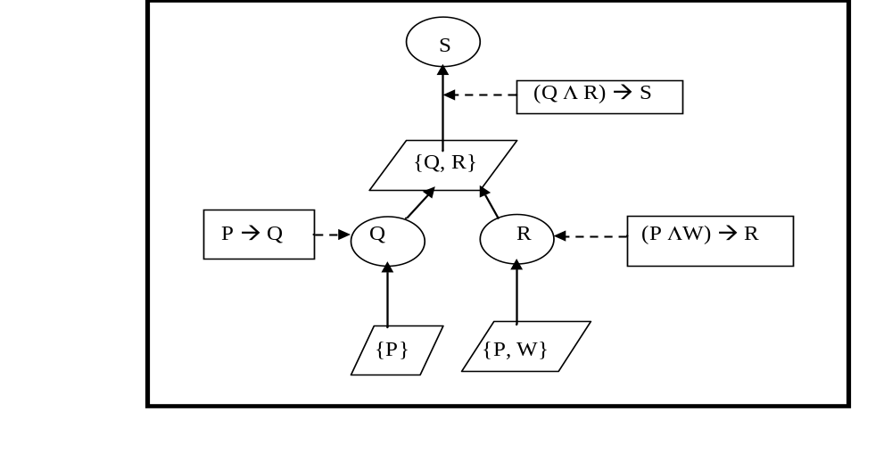
Justification Tree

Slide 6
Non-Monotonic TMS
TMS basically operates with two kinds of objects
  ‘Propositions’ declaring different beliefs and
  ‘Justifications’ related to individual propositions for backing up the belief or disbelief expressed by the proposition.
For every TMS, there are two kinds of justifications required namely ‘Support list’ (SL) and ‘Conditional proof’ (CP).
Support list (SL):
It is defined as “SL(IN-node)(OUT-node)”, where IN-node is a list of all IN-nodes (propositions) that support the considered node as true.
  Here IN means that the belief is true.
  OUT-node is a list of all OUT nodes. OUT means that belief is not true.

Slide 7
TMS
A premise is a fundamental belief which is assumed to be always true.
Premises need no justifications.
They form a base from which all other currently active nodes can be explained in terms of valid justifications.

Slide 8
TMS
There are two types of justification records maintained for nodes: support lists (SL) and conceptual dependencies (CP).
SLs are the most common type. They provide the supporting justifications for nodes.
The data structure used for the SL contains two lists of other dependent node names, an in-list and out-list.

Slide 9
TMS
It has the form
(SL <in-list> ,out-list).
In order for a node to be active and, hence, labeled as IN the belief set, its SL must have at least one valid node in its in-list.
All nodes named in its out-list, if any, must be marked OUT of the belief set.

Slide 10
TMS
Conceptual Dependencies (CP).
A belief may be justified on the basis of several other beliefs, by the conditional proof on one belief relative to other beliefs, or by the lack of belief in some fact.
We discuss this topic latter on.

Slide 11
Non Monotonic TMS Example
Let us consider, a current belief set that represents Cybil as a nonflying bird (an ostrich) might have the nodes and justifications listed in Table 5.1.

Slide 12
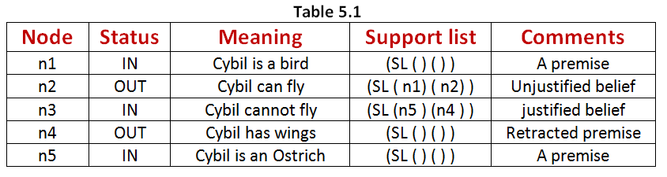

Slide 13
Each IN-node given in table 5.1 is part of the current belief set.
Nodes n1 and n5 are premises.
They have empty support lists since they do not require justifications.
Node n2, the belief that Cybil can fly is out because n3, a valid node, is in the out-list n2.

Slide 14
Suppose it is discovered that Cybil is not an ostrich, thereby causing n5 to be retracted (making its status as OUT).
Then n3, which depends on n5, must also be retracted.
This, in turn, changes the status of n2 to be a justified node.
The resultant belief set is now that the bird Cybil can fly.

Slide 15
To represent a belief network, the symbol conventions shown in Figure 5.2 are sometimes used.
The meanings of the nodes shown in the figure are
(1) a premise is a true proposition requiring no justification,
(2) an assumption is a current belief that could change,
(3) a datum is either a currently assumed or IE derived belief, and
(4) justifications are the belief (node) supports, consisting of supporting antecedent node links and a consequent node link.

Slide 16
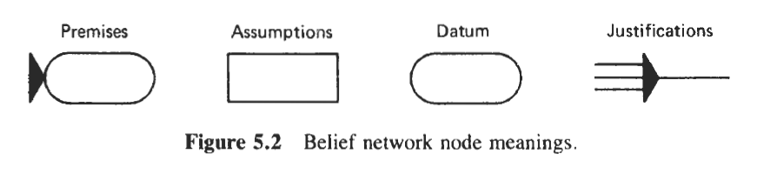

Slide 17
An example of a typical network representation is given in Figure 5.3.
Note that nodes T, U and W are OUT since they lack needed support from P.
If the node labeled P is made IN for some reason, the TMS would update the network by propagating the “inness" support provided by node P to make T,U and W IN.

Slide 18
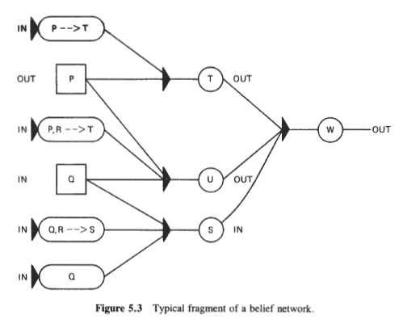

Slide 19
Conditional Proof/ Conceptual dependencies (CP).
A belief may be justified on the basis of several other beliefs, by the conditional proof on one belief relative to other beliefs, or by the lack of belief in some fact.
These are justifications which support belief if a specified belief follows from a set of other beliefs.
Truth maintenance processing is required when new justifications change previously existing beliefs.
In such cases, the status of all beliefs depending on the changed beliefs must be predetermined.
Dependency-directed backtracking is a powerful technique based on the representations of the truth maintenance system.

Slide 20
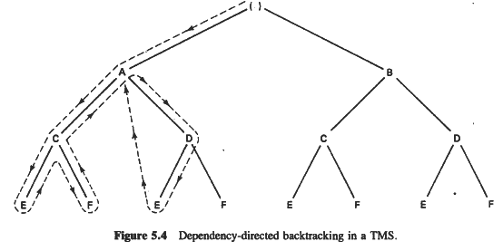

Slide 21
Conditional Proof/ Conceptual dependencies (CP).
Backtracking directly to the node causing the contradiction is known as dependency-directed backtracking (DDB).
This is clearly a more efficient search strategy than chronological backtracking.
This process is illustrated in Figure 5.4 where it is assumed that A and D are contradictory.

Slide 22
By backtracking directly to the source of a contradiction (the dashed line from E to A), extra search time is avoided.
CP justifications are used less frequently than the SLs.

Slide 23
Example
Suppose a system is being used to schedule aircraft and crews for commercial airline flights. The type of aircraft normally scheduled for a given flight is a 737, and the crew required is class A.
The nodes and justifications for these facts might be

Slide 24
Conceptual dependencies (CP).
CL justifications are used less frequently than the SLs.
They justify a node as a type of valid hypothetical argument.
The internal form of a CP justification is as follows:
(CP <consequent><inhypotheses><outhypotheses>)

Slide 25
Example
Suppose a system is being used to schedule aircraft and crews for commercial airline flights.
The type of aircraft normally schedule for a given flight is a 737 and the crew required is class A. The nodes and justifications for these facts might be as follows:

Slide 26
Where the justifications for n1 and n2 (with OUT status) and for n3 is nodes n8, n9, …., n22 which relate to the availability of a captain, copilot and other crew members qualified as class A.
Node | Status | Meaning | Support List
n1 | IN | Type(aircraft)=737 | (SL( )(n2))
n2 | OUT | Type(aircraft)=L400
n3 | IN | Class(crew)=A | (SL(n8,n9,........,n22))

Slide 27
Now suppose it is learned that a full class A crew is not available.
To complete a schedule for the flight, the system must choose an alternative aircraft, say an L400.
To do this the IE changes the status of n2 to IN.
But this results in a contradiction, and hence, creation of the node,
Node | Status | Meaning | Support List
n4 | IN | contradiction | (SL(n1,n3 )())

Slide 28
The contradiction now initiates the DDB procedure in the TMS to locate the offending assumptions.
Since there is only one such node n1, its retraction is straightforward. For this, the TMS creates a “nogood” node with a CP justification as
Node | Status | Meaning | Support List
n5 | IN | nogood n1 | (CP n4(n1,n3 )( ))

Slide 29
To correct the inconsistency, the TMS next makes n2 an IN node by justifying it with n5 as follows:
Node | Status | Meaning | Support List
n5 | IN | type(aircraft)=L400 | (SL (n5 )( ))

Slide 30
This in turn causes n1 to become OUT (as an assumption n1 has a nonempty outlist).
This gives the following set of nodes:
Node | Status | Meaning | Support List
n1 | OUT | Type(aircraft)=737 | (SL( )(n2))
n2 | IN | Type(aircraft)=L400 | (SL( n5)(n2))
n3 | IN | Class(crew)=A | (SL(n8,n9,........,n22))
n4 | OUT | contradiction | (SL( n1, n3)())
n5 | IN | nogood n1 | (CP n4(n1,n3 )( ))

Slide 31
Note that a CP justification was needed for the “nogood”, node to prevent a circular retraction of n2 from occurring.
Had an SL been used for n5 with an n4 node in-list justification, n5 would have become OUT after n4 again causing n2 to become OUT.

Slide 32
THE END

